Slide 1
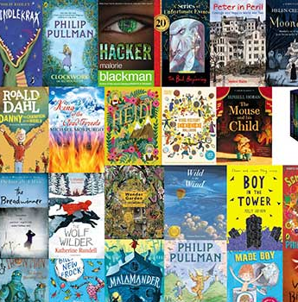
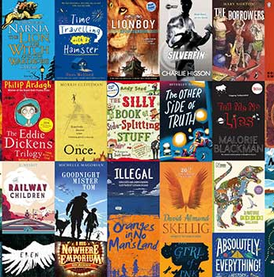

Slide 2
What do the statistics tell us?
27% of students come into secondary school (Y7) below the expected standard (DfE, 2019)
25% of 15-year-olds have a reading age of 12 or below (GL Assessment, 2020)
16.4% of adults in England are functionally illiterate (NLT, 2012)
Reading aids with cognitive development and impacts positively across the curriculum – readers likely to do ‘significantly better’, with a 9.9% advantage in Maths alone. (IoE, 2013).
Researchers found that the strongest factor affecting pupils’ science scores is reading comprehension (EEF, 2017)
Reading improves children’s vocabulary by 26% regardless of background (Centre for Longitudinal Studies, November 2017)
Reading independently is a more important indicator of success than socio-economic/educational status of parents (OECD/PISA 2009)
By age 15, there is a gap equivalent to 8.5 years of schooling between the highest and lowest 10% of readers (PISA 2018)
Notes:
around 16% of adults in England have very poor literacy.[
At this level, they will struggle to understand price labels, read instructions on medicines, make sense of a train timetable or fill in a job application.
Adults with low literacy are more likely to have fewer job opportunities and a lower income.[
The most recent data published by the Ministry of Justice shows that 57% of adult prisoners taking initial assessments had literacy levels below those expected of an 11-year-old.
A quarter of young offenders in the UK have a reading age below that of the average 7-year-old

Slide 3
What percentage of text-lexis (words we can understand and comprehend) do we need to know to access a text?
75%
85%
95%
“The more words you know the easier you’ll find it to guess the meaning of unfamiliar words”
Didau (2014)

Slide 4
85%
Then, in 2005, a team of scientists unearthed thousands of dodo bones in some mud flats in Mauritius. The remains date back to over 4,000 years ago, when the island was suffering from a lengthy drought. The mud flats would have formed a freshwater oasis in an otherwise parched environment. It is thought that most of the animals, while trying to reach the slowly receding waters of the lake, became stuck and died of thirst or suffocation. However, clearly some dodos survived as they did not become extinct until much later. This discovery is helping to rehabilitate the image of this much-ridiculed bird. The very fact that the dodo was still alive and well on Mauritius 4,000 years after a drought that claimed the lives of thousands of animals is an indication of the bird’s ability to survive. The remains are also helping scientists to find out more about the anatomy of the dodo, for example that it was a much slimmer bird than any pictures suggest

Slide 5
95%
Then, in 2005, a team of scientists unearthed thousands of dodo bones in some mud flats in Mauritius. The remains date back to over 4,000 years ago, when the island was suffering from a lengthy drought. The mud flats would have formed a freshwater oasis in an otherwise parched environment. It is thought that most of the animals, while trying to reach the slowly receding waters of the lake, became stuck and died of thirst or suffocation. However, clearly some dodos survived as they did not become extinct until much later. This discovery is helping to rehabilitate the image of this much-ridiculed bird. The very fact that the dodo was still alive and well on Mauritius 4,000 years after a drought that claimed the lives of thousands of animals is an indication of the bird’s ability to survive. The remains are also helping scientists to find out more about the anatomy of the dodo, for example that it was a much slimmer bird than any pictures suggest
Notes:
Dodo Text SATS 2016

Slide 6
Accelerated Reader: A Guide for Parents
All students take at Walkwood take part in the Accelerated Reader programme, which is designed to do the following things:
Find books that are the right ability for your child
Encourage your child to read more
Improve your child’s reading ability.

Slide 7
At the start of the year every student took a Star Test, which is a computer-based test that measures a student’s reading ability through a series of 34 questions.
Every test for every student is different, and the computer selects different questions for each student dependent on how well they answer the previous questions. Essentially, the computer adapts the test to suit your child.
Once the student has completed the test, they are then given a ZPD score by their teacher.
Notes:
https://ukhosted62.renlearn.co.uk/1892677/default.aspx If they can’t find it

Slide 8
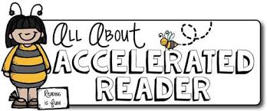
How STAR tests work
The student must take their time. It is recommended that each child should spend at least 20 minutes on their tests. Students are used to working quickly in timed conditions, but during a STAR test it is about concentration, focus and careful reading.
Students should not guess answers to questions. Instead, they should wait for the question to time out. This is to ensure the computer is not given a false impression of the student’s reading ability.
Tests are done in exam conditions without any help from other students or the teacher.

Slide 9
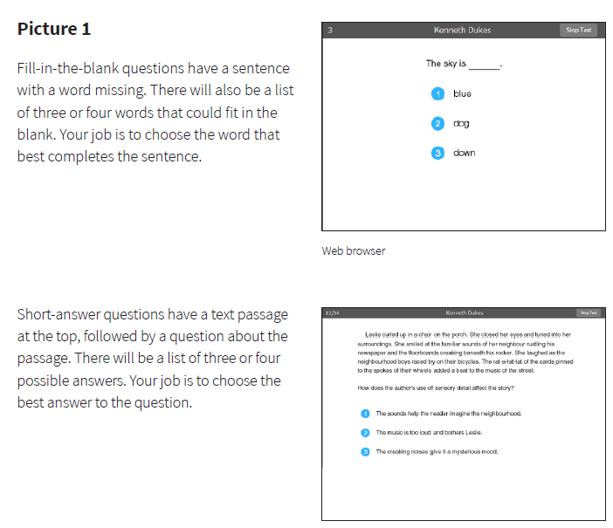

Slide 10
A ZPD score is given to your child after completing the STAR test
3.2 – 4.6
ZPD is two numbers that the student uses to choose their next reading book.
The lowest number is the lowest level of book the student should be choosing.
The highest number is the highest level of book the student should be choosing.
Students keep a record of all their ZPDs in their planners or exercise books.
A new STAR test takes place every half term, so students can see improvements in their reading ability, but also choose more challenging books.
Lowest number
Highest number

Slide 11
AR Quizzes
A quiz is different to a STAR test because students only take a quiz after they have finished a book.
There are usually about 10 questions on the book that has been read. At the end of the quiz the students are given a percentage to show them how well they have done.
There are some important rules for taking quizzes:
The book the child is quizzed on must be a book they have read in the last two weeks. AR is not a memory test but rather measuring reading ability.
A student cannot take a quiz until they have read the entire text.
Quizzes must be done individually, not with anyone’s help.

Slide 12
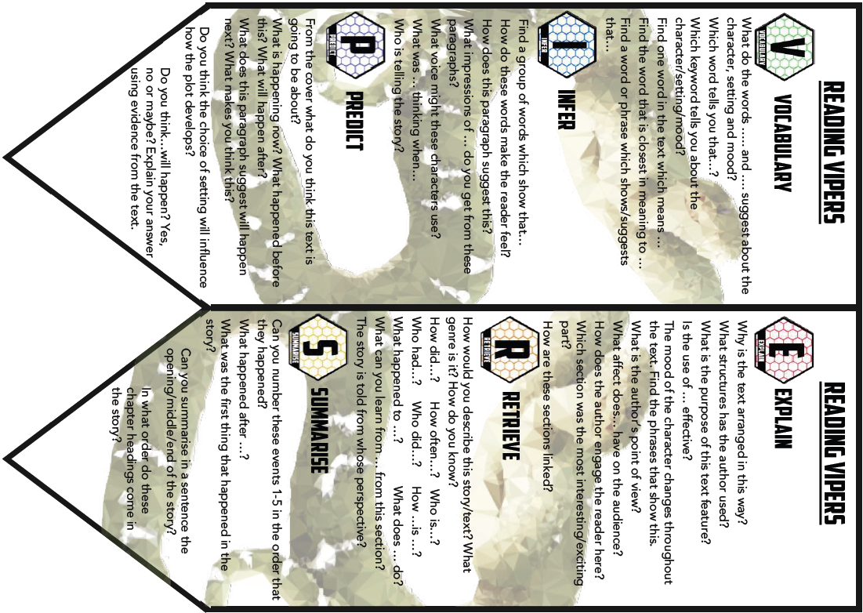
“How can I help?”
As with anything, performance improves with practice.
Encourage your child to read at home.
Create a culture of reading in your household by reading with your child, starting a home library, visiting your local library, charity shop or bookshop on a regular basis and by letting your child see you reading.
When reading with your child stop and ask questions to be sure your child comprehends what they have read and in general make a habit of discussing books that each of you has read.

Slide 13
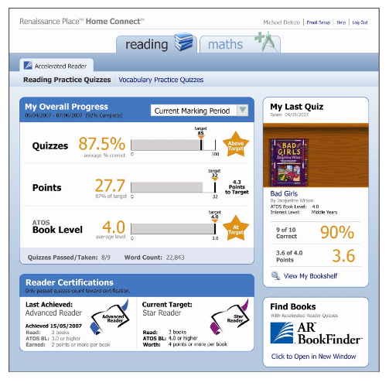
How will I know how my child is doing?
You can access your child’s AR information in Renaissance Place Home Connect from any web-enabled computer.
Once in the programme, you can view your child’s progress towards targets, points and books read.
You can also access AR BookFinder to search for titles of interest.
You can only access information about your own child.

Slide 14
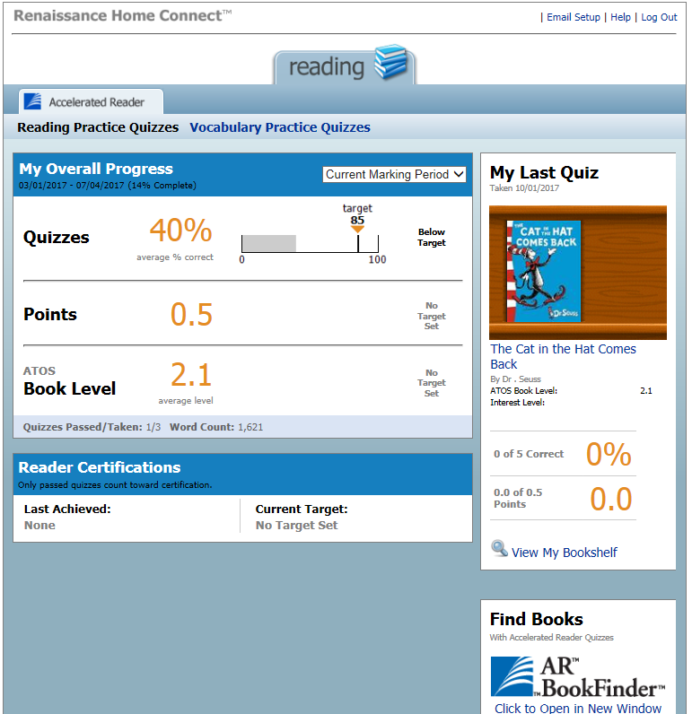
Average quiz score
Points earned
Average book level.
Last book read and quizzed on. Include % correct and points earned from book.

Slide 15
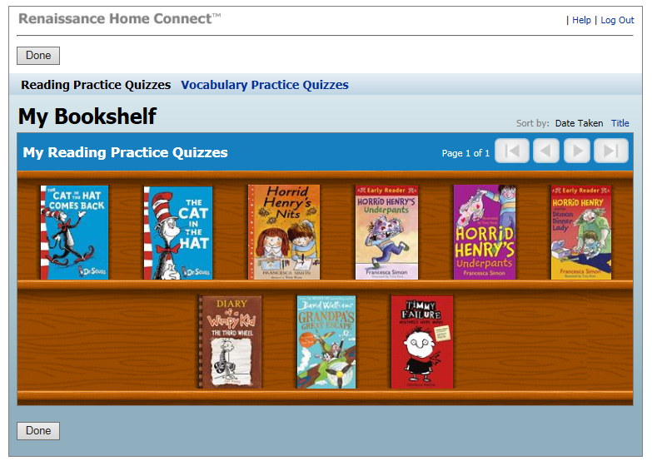
Your child’s bookshelf

Slide 16
Questions?

